Slide 1
Data Structures and Algorithms
CSC206
Unit 2:Stack
Shyam Sunder Khatiwada

Slide 2
Stack
It is an ordered group of homogeneous items of elements.
Elements are added to and removed from the top of the stack called TOP.
The last element to be added is the first to be removed (LIFO: Last in, First out).
Push() function is used to insert new elements into the Stack and Pop() function is used to remove an element from the stack. Both insertion and removal are allowed at only one end of Stack called TOP.
Stack is said to be in Overflow state when it is completely full and is said to be in Underflow state if it completely empty.

Slide 3
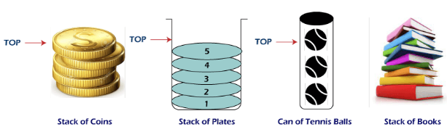
Stack example:
An everyday analogy of a stack data structure is a stack of books on a desk, stack of plates, table tennis, stack of bottles, Undo and Redo mechanism in the Text Editors, etc.
Some key Points:
It is called stack because it behaves like a real-world stack, piles of book etc.
A stack is an abstract data type with a predefined capacity, which means that it can store the elements of a limited size.
It is a data structure that follows some order to insert and delete the elements, and that order can be LIFO or FILO.

Slide 4
Basic Operation in Stack
Push - Add an element to the top of a stack
Pop- Remove an element form the top of a stack
IsEmpty- Check if the stack is empty
IsFull - Check if the stack is full
Peek- Get the value of the top element without removing it from the stack

Slide 5
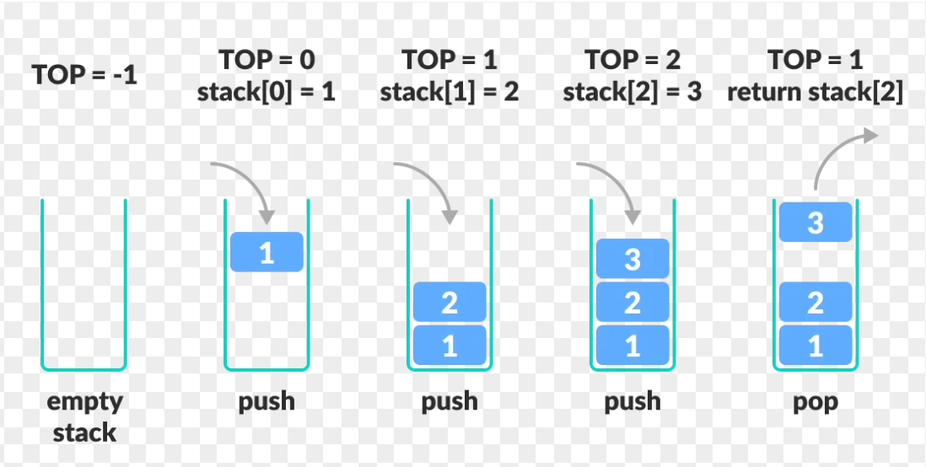
stack operation:

Slide 6
Working of Stack
A pointer called TOP is used to keep track of the top element in the stack.
when initializing the stack, we set its value to -1 so that we can check if the stack is empty by comparing TOP = = -1.
On pushing an element, we increase the value of TOP and place the new element in the position pointed to by TOP.
On popping an element, we return the element pointed to by TOP and reduce its value.
Before pushing, we check if the stack is already full.
Before popping, we check if the stack is already empty

Slide 7
Stack Implementation
In this case of array, stack is also collection of homogeneous elements.
Therefore stack can be easily implemented using array.
Elements stored form stack[0] to stack[TOP].
stack[0] → Bottom of the stack
stack[TOP] → Top of the stack
TOP= -1 → Indicate stack is empty.

Slide 8
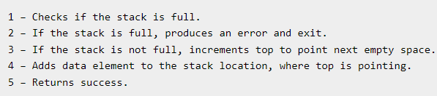
Algorithm:push( )

Slide 9
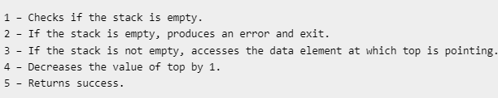
Algorithm: pop( )

Slide 10
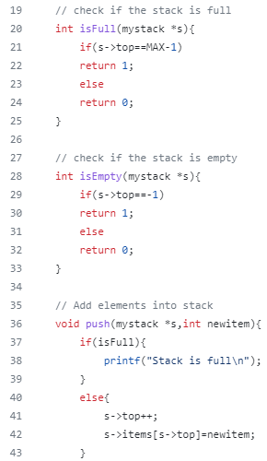
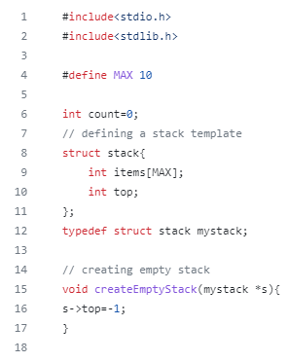
Stack code:

Slide 11
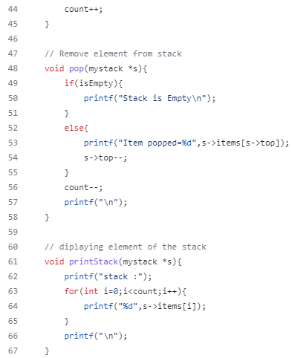
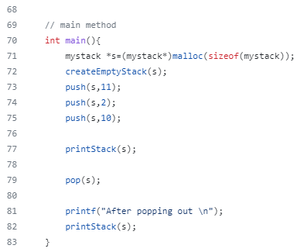
Stack code:

Slide 12
GitHub Link:
Stack implementation using c :
Stack implementation using c: Click Here

Slide 13
Stack Applications:
Functions calls and recursion:
When a function is called the current state of the program is pushed onto the stack.
When the function is returns, the state is popped from the stack to resume the previous function’s execution.
Undo/Redo operations:
The undo-redo feature in various applications uses stacks to keep track of the previous actions.
Each time an action is performed, it is pushed onto stack.
To undo the action, the top element of the stack is popped, and the reverse operation is performed.

Slide 14
Stack Applications:
Expression evaluation:
Stack data structure is used to evaluate expressions in infix, postfix, and prefix notations.
Operators and operands are pushed onto the stack, and operations are performed based on the stack’s top elements.
Browser history:
web browsers use stacks to keep track of the web pages you visit.
Each time you visit a new page, the URL is pushed onto the stack, and when you hit back button, the URL is popped from the stack.

Slide 15
Stack Applications:
Balanced Parentheses:
Stack ds is used to check if parentheses are balanced or not.
An opening parenthesis is pushed onto the stack, and a closing parenthesis is popped from the stack.
Backtracking Algorithms:
The backtracking algorithm uses stack to keep track of the states of the problem-solving process.
The current state is pushed onto the stack, and when the algorithm backtracks, the previous state is popped from the stack.

Slide 16
Advantages of Stack:
Easy implementation: it is easy to implement using arrays or linked lists, and its operations are simple to understand and implement.
Efficient memory utilization: It uses contiguous block of memory, making it more efficient in memory utilization as compared to other data structures.
Fast access time: It provides fast access time for adding and removing elements as the elements are added and removed from the top of the stack.

Slide 17
Advantages of Stack:
Helps in function calls: It is used to store functions calls and their states, which helps in the efficient implementation of recursive functions calls.
Supports backtracking: It supports backtracking algorithms, which are used in problem solving to explore all possible solutions by storing the previous states.
Used in Compiler Design: It is used in compiler design for parsing and syntax analysis of programming languages.
Enables undo/redo operations: It is used to enable undo and redo operations in various applications like text editors, graphic design tools, and software development environments.

Slide 18
Disadvantages of Stack:
Limited capacity:
It has a limited capacity as it can only hold a fixed number of elements.
If the stack becomes full, adding new elements may result in stack overflow, leading to the loss of data.
No random access:
it does not allow for random access to its elements, and it only allows for adding and removing elements from the top of the stack.
Memory management:
it uses a contiguous block memory, which can result in memory fragmentation if elements are added and remove frequently.

Slide 19
Disadvantages of Stack:
Not suitable for certain applications:
it is not suitable for applications that require accessing elements in the middle of the stack, like searching or sorting algorithms.
Stack overflow and underflow:
it result in stack overflow if too many elements are pushed onto the stack.
it can also result in stack underflow if too many elements are popped from the stack.
Recursive function calls limitations:
it supports recursive function calls, too many recursive function calls can lead to stack overflow, resulting in termination of program.

Slide 20
Stack as an ADT:
When we define a stack as ADT (abstract data types), then we are only interested in knowing the stack operations from the user point of view.
User is not interested in implementations details, they are interested in what type of operations can be performed.
Stack as an ADT can be implemented using array and linked lists.

Slide 21
Parentheses matching using stack in c
Algorithm:
Declare a structure for character stack.
Now traverse the expression String expressions.
If the current character is a starting parentheses (‘(’), then push into the stack.
If the current character is a closing bracket (‘)’), then pop from the stack and if the popped character is the matching starting bracket then fine else brackets are not balanced.
After complete traversal, if there is parenthesis left in stack then “NOT BALANCED”.

Slide 22
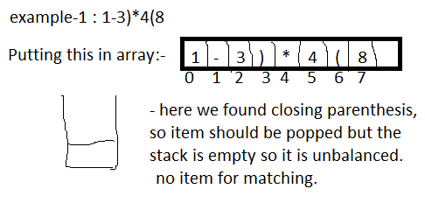
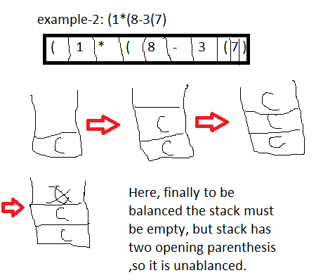
example:

Slide 23
Condition for a balanced expression
while popping stack should not underflow:
if it happens, it is unbalanced expression.
At the End of Expression (EOE), the stack must be empty:
if not happens, it is unbalanced expression.

Slide 24
Workout:
expression: (7*8)-3(7)
expression: ((3*2)-1(8-2)
expression: ((1-3)*4)

Slide 25
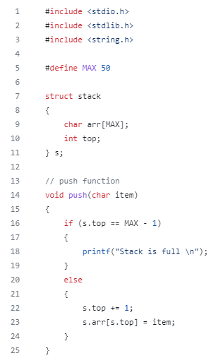
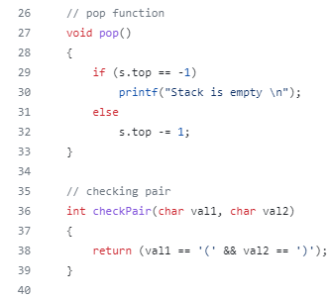
Code:

Slide 26
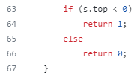
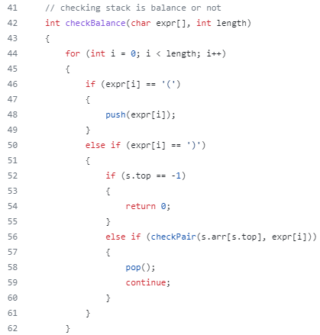
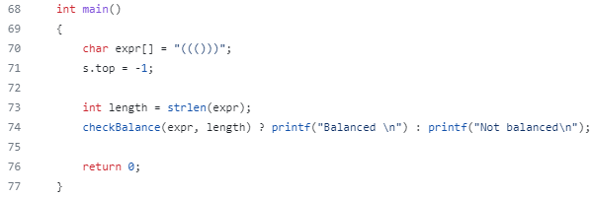
Code:

Slide 27
GitHub Link:
Parentheses matching using stack in c:
Parentheses matching using stack in c: Click Here

Slide 28
Introduction:Infix, prefix and postfix notation
Mathematical formulas are often made more accessible by using parenthesis. However, in computer, expressions with multiple parentheses are can be inefficient.
So, mathematicians have created different notations such as infix, postfix and postfix expressions to reduce computational work.

Slide 29
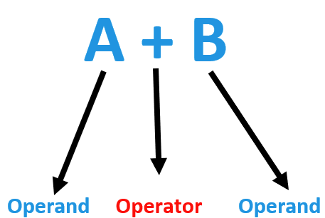
Infix Expressions
Infix expressions are the most usual type of expressions. This notation is typically employed when writing arithmetic expressions by hand. Moreover, in the infix expression, we place the operator between the two operands it operates on.
For example, the “+” appears the operands A and B in the expresson “A+B”. The following figure depicts the example:
Furthermore, infix expressions can also include parentheses to indicate the order of operations. In this way, we should observe the operator precedence rules and use parentheses to clarify the order of operations in expressions in infix notation.

Slide 30
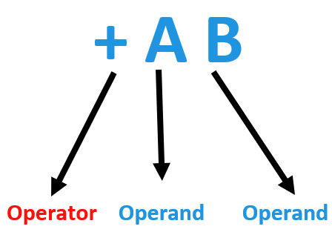
Prefix Expressions
Prefix expressions, also known as Polish notation, place the operator before the operands.
For example, in the expression “+AB”, we place the “+” operator before the operands A and B, as demonstrated in the image.

Slide 31
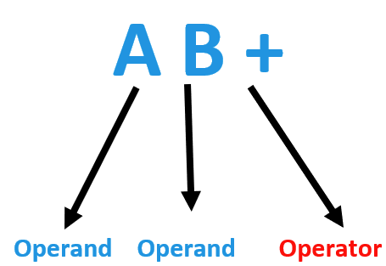
Postfix expressions
Postfix expressions, also known as reverse Polish notation, where we place the operator after the operands.
For instance, in the expression “AB+”, the “+” we place the operator operator after the operands A and B. The figure depicts the example:

Slide 32
Comparison of the Expression notations:
The infix notation is the simplest notation for humans to read and write, but it requires more complex parsing algorithms for computers due to parentheses and operator precedence rules.
The prefix and postfix notations are computationally efficient and do not require parentheses or operator precedence tracking.
Furthermore, the prefix notation can easily handle unary operators. while infix and postfix notations require special handling.
The infix notation uses parentheses for functions arguments. while the prefix and postfix notations can use other delimiters.
The infix notation is the most usual notation for writing mathematical expressions, while the prefix and postfix notations are appropriate for particular applications.

Slide 33
Operator Precedence and Associativity
During the conversion and evaluation of expressions, operator precedence and associativity plays an important role, some basic Operators precedence and associativity are :
Operator and Precedence | Associativity
Brackets → [ ], { }, ( ) | Left to Right
Exponentiation → ^ | Right to Left
Multiplication and Division → *, / | Left to Right
Addition and Subtraction → +, - | Left to Right

Slide 34
Example: Evaluation of infix expression
Example 1:
expression: A+B*C
First, Parenthesized the expression.
→ (A+(B*C))
Second, follow the precedence rule to evaluate
→ (A+result of B*C)
→ Result of (A+result of B*C)
Example 2:
expression: A+B-C
→ following first step, both + and - have same precedence, so which will evaluate first, in such case we have to follow the associativity.
→ The association of +, - is Left to Right.
(A+B)-C
Here first (A+B) and result will subtract from C.

Slide 35
Why conversion from infix to prefix/postfix?
Infix | Postfix | Prefix
(A+(B*C)) | ABC*+ | +A*BC
While evaluating an expression, it must be fully parenthesized and used of stack. | While evaluating, we can use stack directly. | While evaluating, we can use stack directly.
Infix needs parentheses in order to evaluate which human can distinguish the order of operators and also can use parentheses to solve that part.
The computer cannot differentiate the operators and parentheses easily. So,
so we need conversion:
Infix → postfix OR Infix → prefix

Slide 36
Infix to Postfix : Manual Method
Example 1: A +B/C*D
Follow the operator precedence and associativity(can use parentheses in infix)
→ (A +((B/C) *D))
Put each operator out of parentheses it belongs- back of ( )
→ (A+(BC/*D)) [ B/C→ BC/]
→(A+BC/D*) [ (BC/)*D) →BC/D*]
→ ABC/D*+ [(A+BC/D*) →ABC/D*+]
postfix expression

Slide 37
Infix to Postfix : Workout
Workout 1: A-B*C+D/E
Workout 2: A+B*C^(D*E)/S
Workout 3: A*(B+C)*D
Workout 4: x-y*z
Workout 5: p-q-r/a

Slide 38
Infix to prefix: Manual Method
Example 1: A+B*C-D/E
first, parenthesized the expressions, follow precedence and associativity.
→ ((A+(B*C))-(D/E))
put each operator out of parentheses it belongs, in-front of ( )
→ ((A+*BC)- (D/E))
→ (A+*BC)- /DE)
→ (+A*BC- /DE)
→ -+A*BC/DE → (prefix expression)

Slide 39
Conversion: infix to postfix → using stack
Algorithm:
Step 1: The infix notation is passed from left to right.
Step 2: If we have an opening parenthesis “(” we push into the stack.
Step 3: If we have an operand, we append it to our postfix expression ( print it).
Step 4: If we have a closing parenthesis “)” we keep popping out elements from the top of the stack and append them to our postfix expression until we encounter an opening parenthesis. we pop out the left parenthesis without appending.
Step 5: If the operator has higher precedence than the one on top of the stack(we can compare), we push it in the stack.
Step 6: If the operator has lower or equal precedence then one on top of the stack, we keep popping out and appending it to the postfix expression and push lower or equal operator.

Slide 40
Example 1: A * (B+C-D)
Infix | Stack | Postfix
A |  | A
* | * | A
( | *, ( | A
B | *, ( | AB
+ | *, (, + | AB
C | *, (, + | ABC
- | *, (, - | ABC+
D | *, (, - | ABC+D
) | * | ABC+D-
 |  | ABC+D-*

Slide 41
Workout:
Workout 1: A + B/C+D*(E-F)^G
Workout 2: (a+b^c*d)*(e+f/g)

Slide 42
Conversion:infix to prefix → using stack
Algorithm:
Step 1: Reverse the infix expression.
Interchange:
Left parenthesis→ Right parenthesis
Right parenthesis → Left parenthesis
Step 2: Convert to postfix using stack
Step 3: Reverse the postfix expression.

Slide 43
Example:
(A+(B*C)^D)
Infix | Stack | Postfix
( | (
D | ( | D
^ | (^ | D
( | (^( | D
C | (^( | DC
* | (^(* | DC
B | (^(* | DCB
) | (^ | DCB*
+ | (+ | DCB*^
A | (+ | DCB*^A
) |  | DCB*^A+
Step 1: Reversing the infix expression: (D^(C*B)+A)
Step 2: Converting to the Postfix:
Step 3: Reverse the postfix:
+A^*BCD

Slide 44
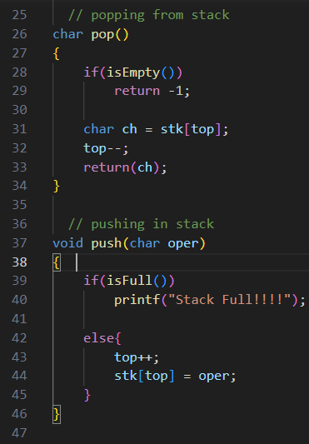
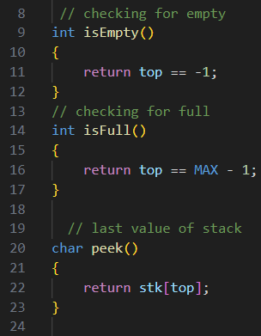
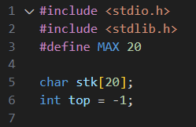
Code: infix to postfix using stack

Slide 45
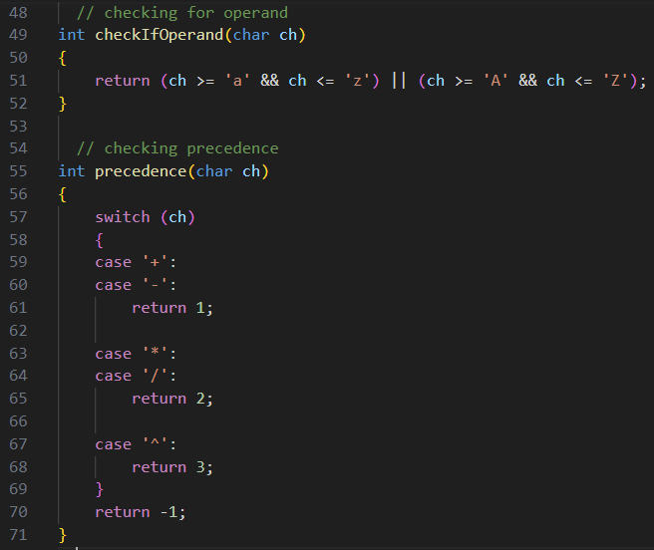
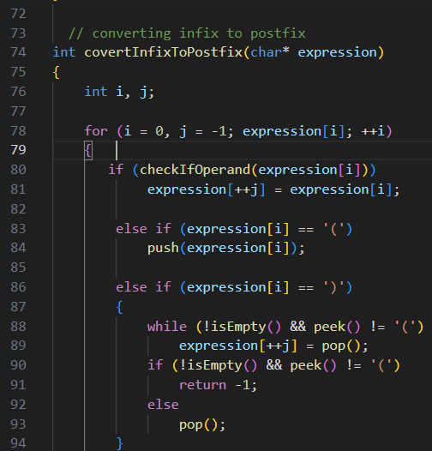
Code: infix to postfix using stack

Slide 46
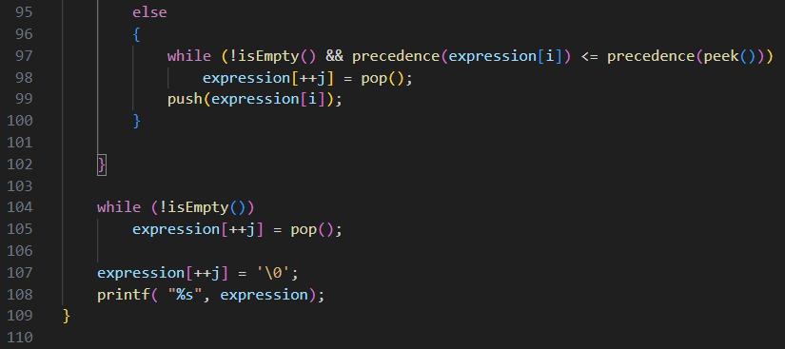
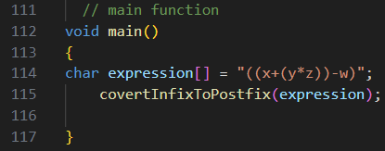
Code: infix to postfix using stack
Output:

Slide 47
GitHub Link: Code
Conversion: Infix to Postfix: Click Here

Slide 48
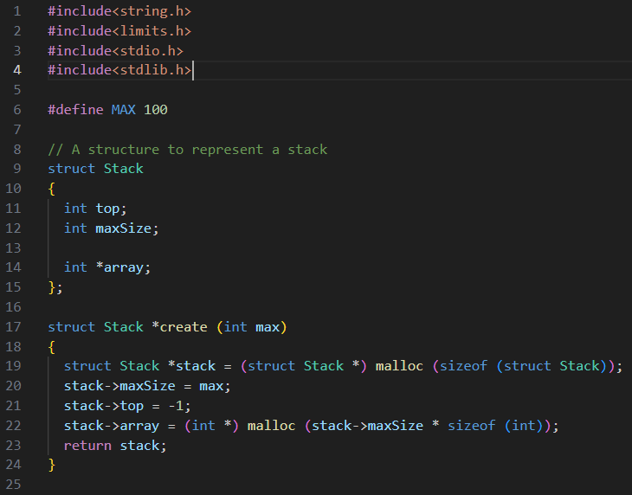
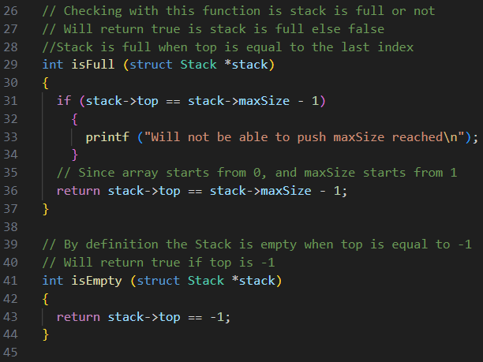
Code: Infix to Prefix Conversion

Slide 49
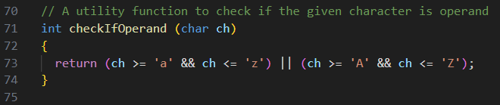
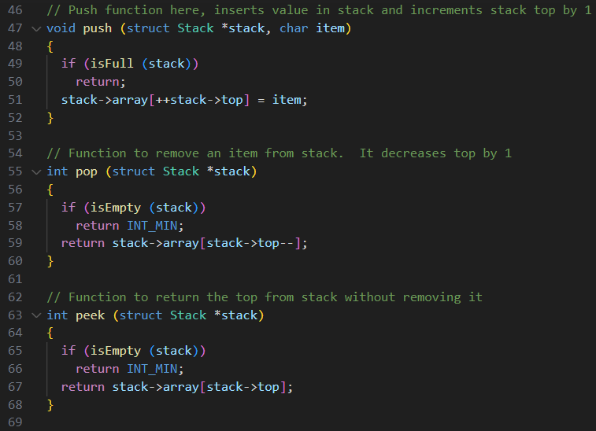
Code: Infix to Prefix Conversion

Slide 50
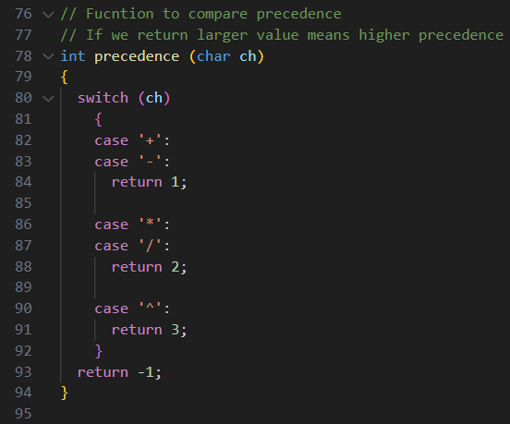
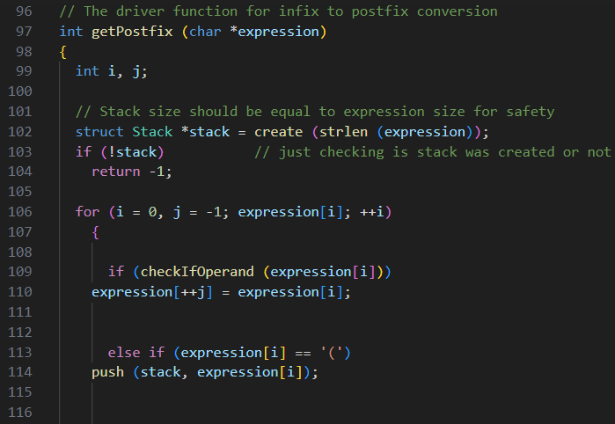
Code: Infix to Prefix Conversion

Slide 51
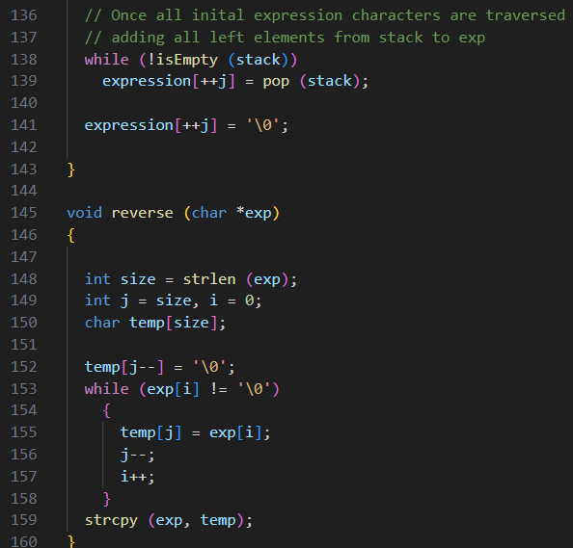
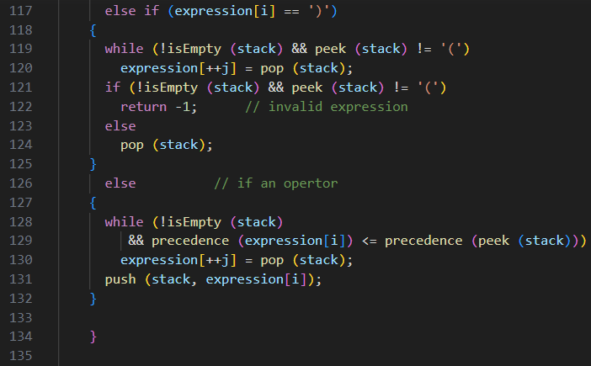
Code: Infix to Prefix Conversion

Slide 52
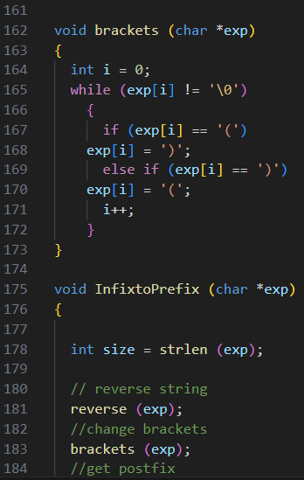
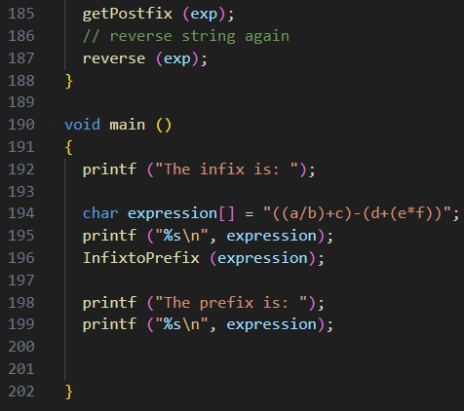
Code: Infix to Prefix Conversion

Slide 53
GitHub Link: Code
Conversion: Infix to Prefix : Click Here

Slide 54
Evaluation: postfix expression
Algorithm:
Step 1: Traverse from left to right
Step 2: If the current character is an operand push it into the stack.
Step 3: If the current character is an operator.
pop a character form the stack, let it be operand2(op2).
pop another character, let it be operand1(op1).
compute the result of op1 and op2, and push it into the stack.
Step 4: When the expression is ended, the number in the stack is the final answer.

Slide 55
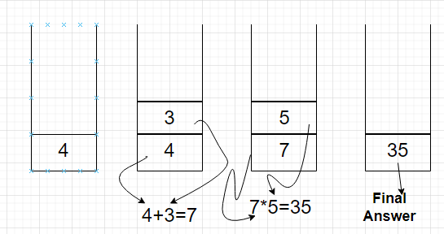
Example: Evaluation postfix expression:
Postfix expression: 43+5*

Slide 56
Alternative: Evaluation of postfix expression:
postfix expression: 43+5*
Postfix | Stack | Result
4 | 4
3 | 4, 3
+ | 7 | 4 + 3 = 7
5 | 7, 5
* | 35 | 7 * 5 = 35

Slide 57
Workout:
What will be the highest size of the operand stack while evaluating the postfix operation?
623+-382/+*

Slide 58
Evaluation: prefix expression:
Algorithm:
Step 1: Traverse prefix expression from right to left.
Step 2: If the current character is an operand push it into the stack.
Step 3: If the current character is an operator:
pop a character from stack, let it be operand1 (op1).
pop another character, let it be operand2 (op2).
compute the result of op1 and op2, push it into the stack.
Step 4: When the expression is ended, the number in the stack is the final answer.

Slide 59
Example: Evaluation prefix expression:
postfix expression: -*482 (Scan from right to left)
Infix | Stack | Result
2 | 2
8 | 2, 8
4 | 2, 8, 4
* | 2,32 | 4 * 8 = 32
- | 30 | 32 -2 = 30

Slide 60
GitHub link: Evaluation postfix expression
Code: Evaluation Postfix Expression: Click Here

Slide 61
workout
Write a program to evaluate the prefix expression using stack.

Slide 62
Any Query?
Thank You!!!

